Slide 1
DATABASE ERD GIDAL

Slide 2
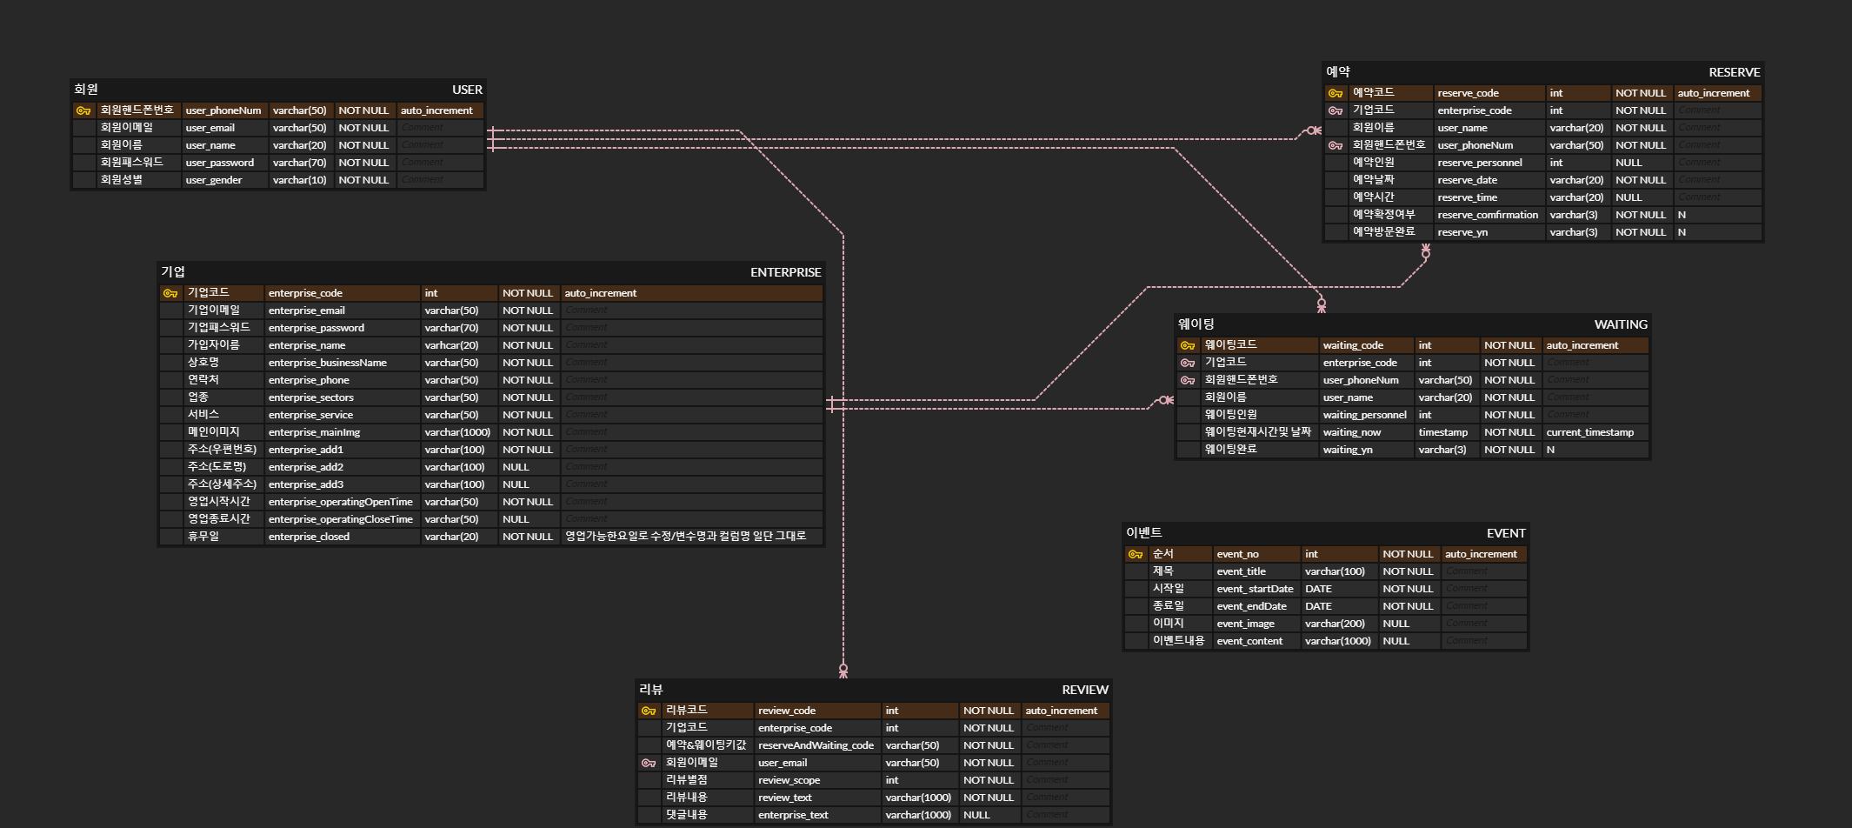
ERD

Slide 3
ENTERPRISE TABLE
CREATE TABLE `enterprise` (
`enterprise_code` INT(10) UNSIGNED ZEROFILL NOT NULL AUTO_INCREMENT,
`enterprise_email` VARCHAR(50) NOT NULL,
`enterprise_password` VARCHAR(70) NOT NULL,
`enterprise_name` VARCHAR(50) NOT NULL DEFAULT '0',
`enterprise_businessName` VARCHAR(50) NOT NULL DEFAULT '0',
`enterprise_phone` VARCHAR(50) NOT NULL DEFAULT '0',
`enterprise_sectors` VARCHAR(30) NOT NULL DEFAULT '0',
`enterprise_service` VARCHAR(30) NOT NULL DEFAULT '0',
`enterprise_mainImg` VARCHAR(100) NOT NULL DEFAULT '0',
`enterprise_add1` VARCHAR(50) NULL DEFAULT '0',
`enterprise_add2` VARCHAR(50) NULL DEFAULT '0',
`enterprise_add3` VARCHAR(50) NULL DEFAULT '0',
`enterprise_operatingOpenTime` VARCHAR(50) NULL DEFAULT '0',
`enterprise_operatingCloseTime` VARCHAR(50) NULL DEFAULT '0',
`enterprise_closed` VARCHAR(20) NULL DEFAULT '0',
PRIMARY KEY (`enterprise_code`))
COLLATE='utf8_general_ci
'ENGINE=InnoDBAUTO_INCREMENT=165;

Slide 4
EVENT TABLE
CREATE TABLE `event` (
`event_no` INT(11) NOT NULL AUTO_INCREMENT,
`event_title` VARCHAR(100) NOT NULL,
`event_startDate` DATE NOT NULL,
`event_endDate` DATE NOT NULL,
`event_image` VARCHAR(200) NULL DEFAULT NULL,
`event_content` VARCHAR(1000) NULL DEFAULT NULL,
PRIMARY KEY (`event_no`))
COLLATE='utf8_general_ci'ENGINE=InnoDBAUTO_INCREMENT=11;

Slide 5
RESERVE TABLE
CREATE TABLE `reserve` (
`reserve_code` INT(11) NOT NULL AUTO_INCREMENT,
`enterprise_code` INT(11) NOT NULL DEFAULT '0',
`reserve_personnel` INT(11) NULL DEFAULT NULL,
`reserve_date` VARCHAR(20) NULL DEFAULT NULL COLLATE 'utf8_bin',
`reserve_time` VARCHAR(20) NULL DEFAULT NULL COLLATE 'utf8_bin',
`user_name` VARCHAR(50) NULL DEFAULT NULL COLLATE 'utf8_bin',
`user_phoneNum` VARCHAR(50) NULL DEFAULT NULL COLLATE 'utf8_bin',
`reserve_yn` VARCHAR(3) NULL DEFAULT NULL COLLATE 'utf8_bin',
`reserve_comfirmation` VARCHAR(3) NULL DEFAULT NULL COLLATE 'utf8_bin',
PRIMARY KEY (`reserve_code`))COLLATE='utf8_bin‘
ENGINE=InnoDBAUTO_INCREMENT=82;

Slide 6
REVIEW TABLE
CREATE TABLE `review` (
`review_code` INT(11) NOT NULL AUTO_INCREMENT,
`enterprise_code` INT(11) NOT NULL DEFAULT '0',
`reserveAndWaiting_code` VARCHAR(50) NULL DEFAULT NULL,
`review_text` VARCHAR(1000) NOT NULL DEFAULT '0',
`user_email` VARCHAR(50) NOT NULL DEFAULT '0',
`review_scope` INT(11) NOT NULL,
`enterprise_text` VARCHAR(1000) NULL DEFAULT NULL,
PRIMARY KEY (`review_code`))COLLATE='utf8_general_ci‘
ENGINE=InnoDBAUTO_INCREMENT=47;

Slide 7
USER TABLE
CREATE TABLE `user` (
`user_phoneNum` VARCHAR(50) NOT NULL,
`user_email` VARCHAR(50) NOT NULL,
`user_name` VARCHAR(20) NOT NULL,
`user_password` VARCHAR(70) NOT NULL,
`user_gender` VARCHAR(10) NOT NULL,
PRIMARY KEY (`user_email`))COLLATE='utf8_general_ci‘
ENGINE=InnoDB;

Slide 8
WAITING TABLE
CREATE TABLE `waiting` (
`waiting_code` INT(11) NOT NULL AUTO_INCREMENT,
`enterprise_code` INT(11) NULL DEFAULT NULL,
`waiting_personnel` INT(11) NULL DEFAULT NULL,
`user_name` VARCHAR(50) NULL DEFAULT NULL COLLATE 'utf8_bin',
`user_phoneNum` VARCHAR(50) NULL DEFAULT NULL COLLATE 'utf8_bin',
`waiting_now` TIMESTAMP NOT NULL DEFAULT '',
`waiting_yn` VARCHAR(3) NULL DEFAULT NULL COLLATE 'utf8_bin',
PRIMARY KEY (`waiting_code`))COLLATE='utf8_bin
'ENGINE=InnoDBAUTO_INCREMENT=71;

Slide 9
USER TABLE

Slide 10
배포구성도 GIDAL

Slide 11
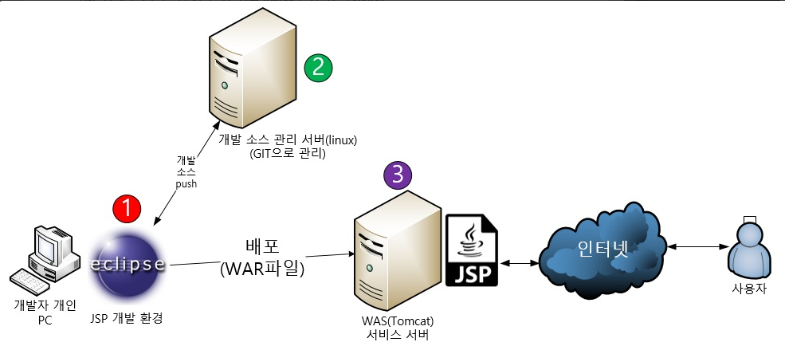
배포구성도

Slide 12
Class diagram GIDAL

Slide 13
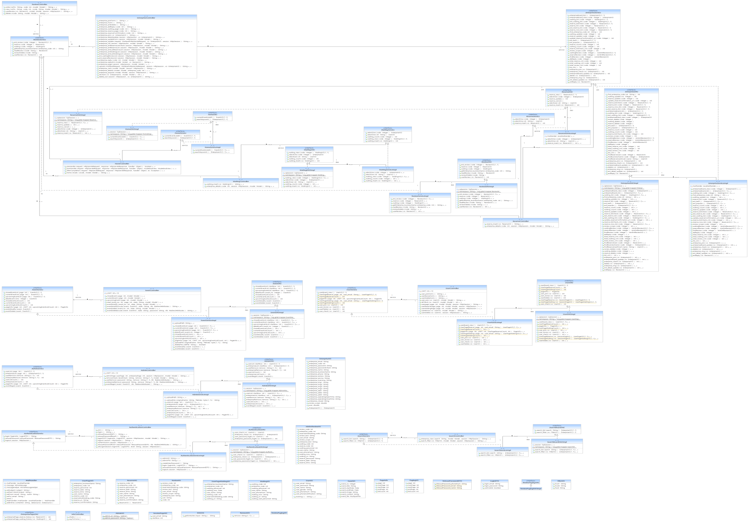
전체 클래스 다이어그램

Slide 14
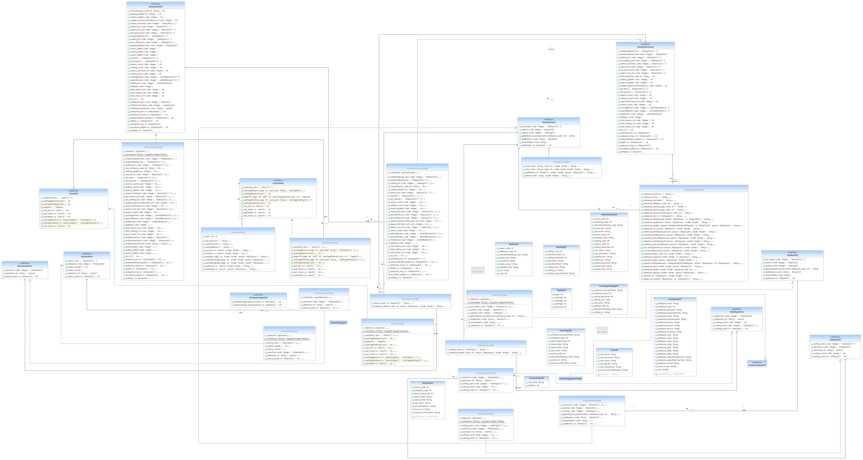
주요 로직 클래스 다이어그램

Slide 15
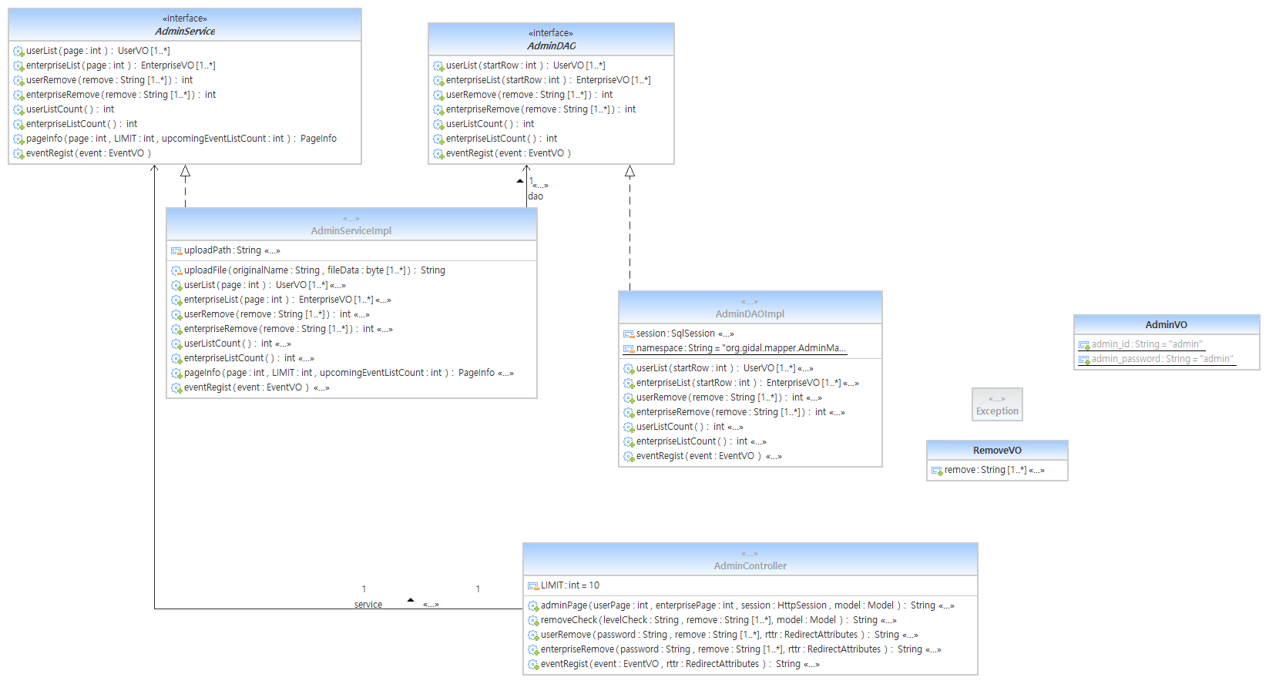
ADMIN

Slide 16
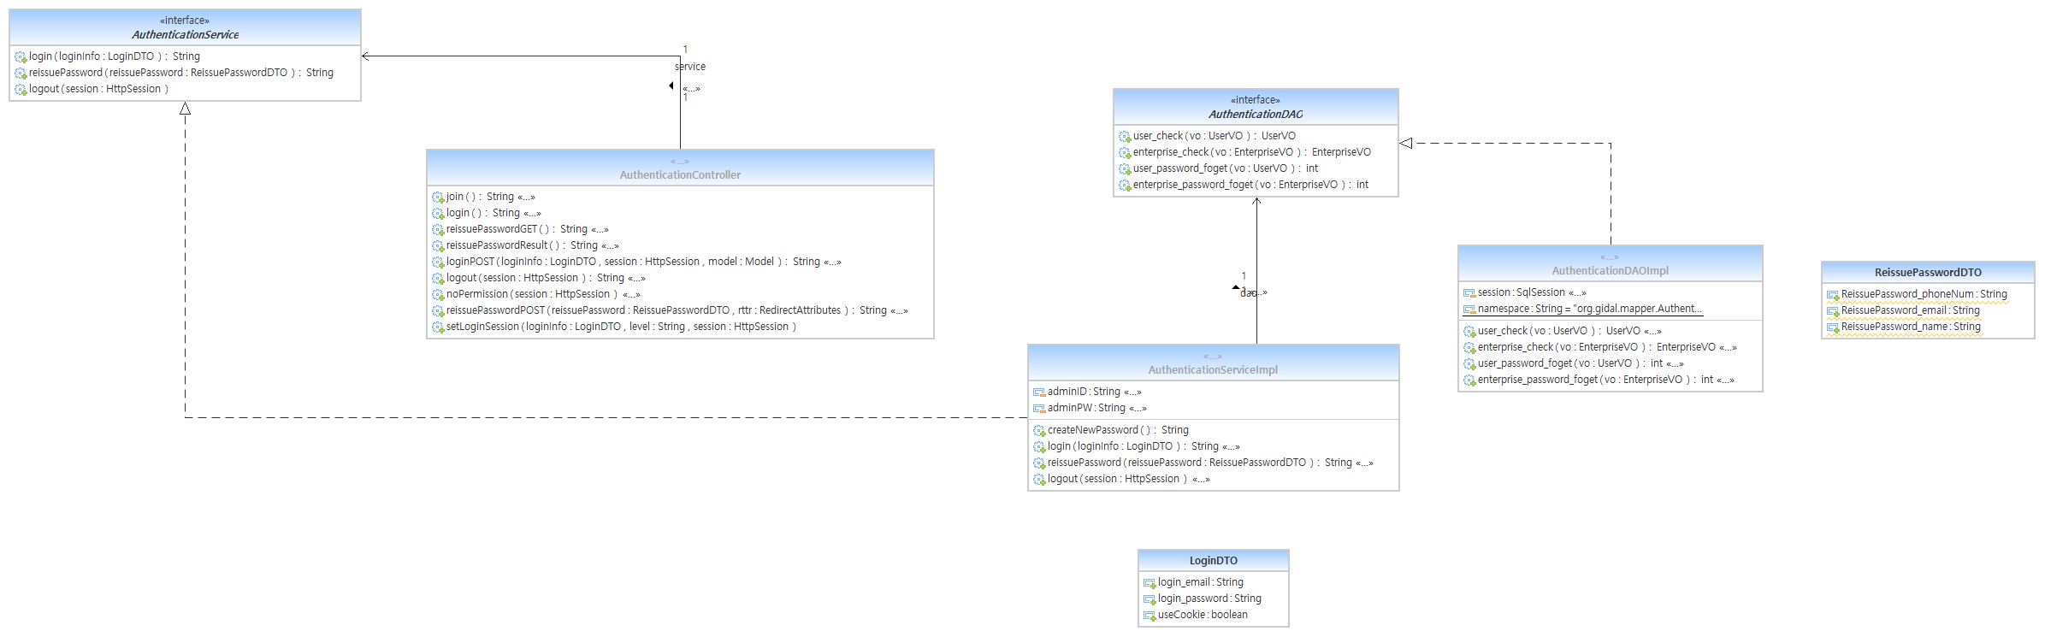
AUTHENTICATION

Slide 17
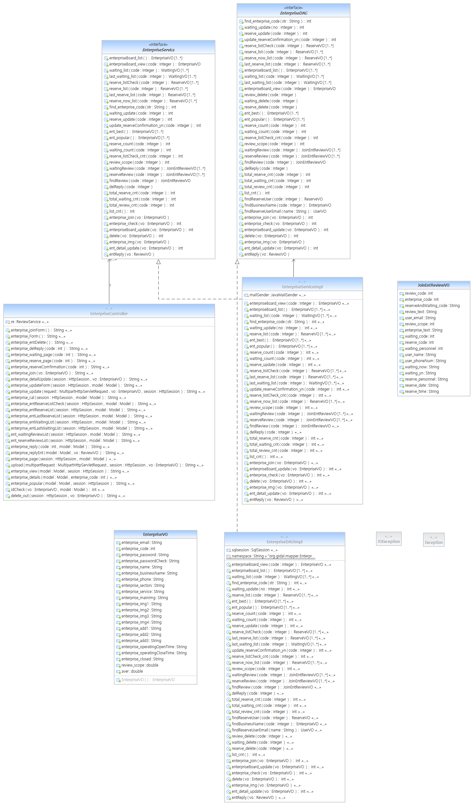
ENTERPRISE

Slide 18
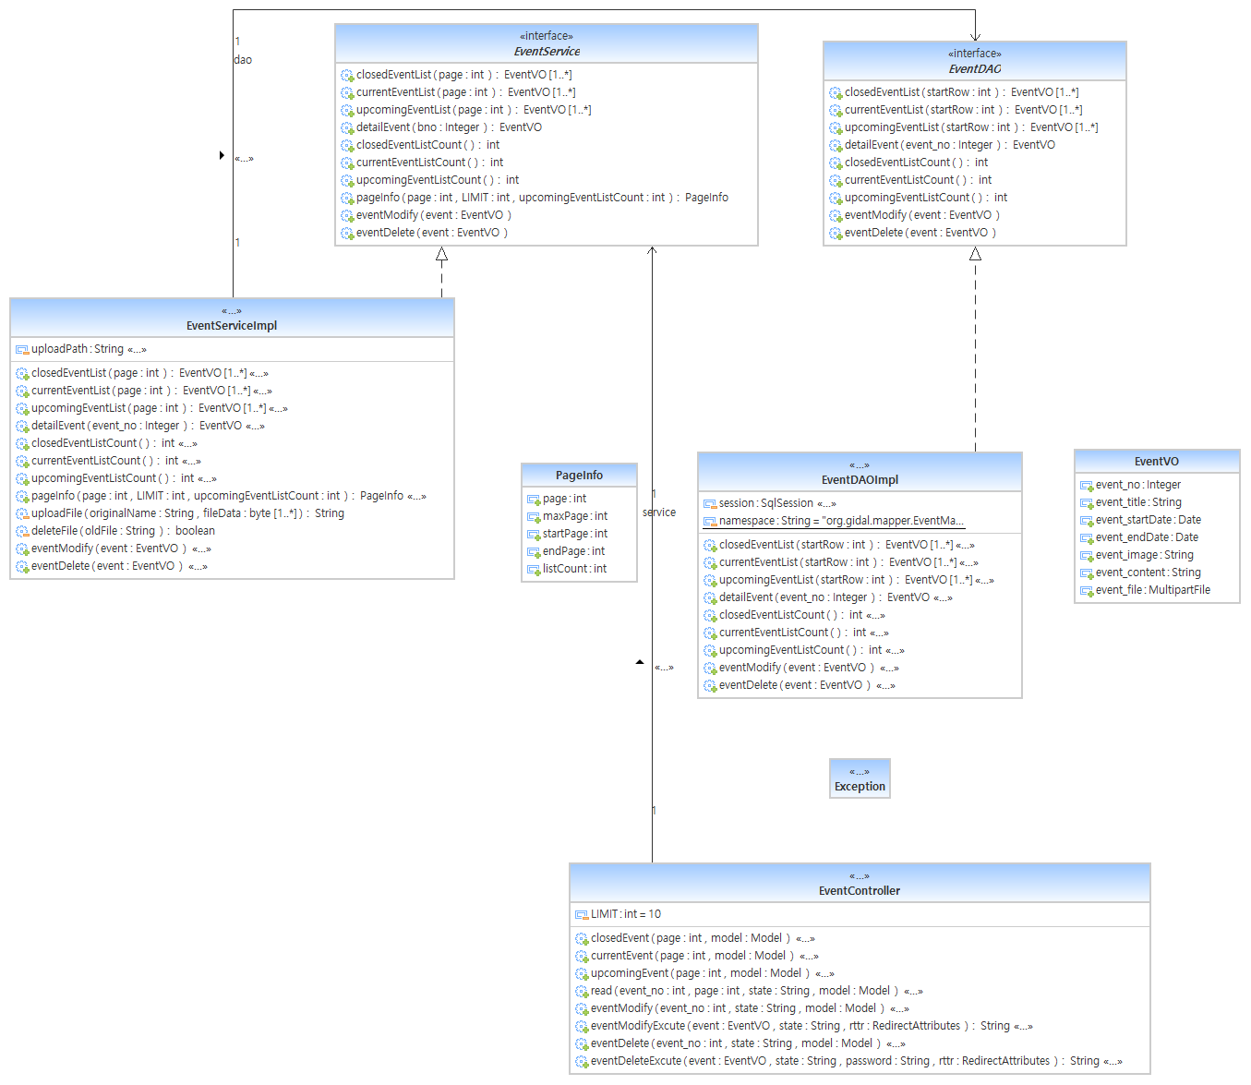
EVENT

Slide 19
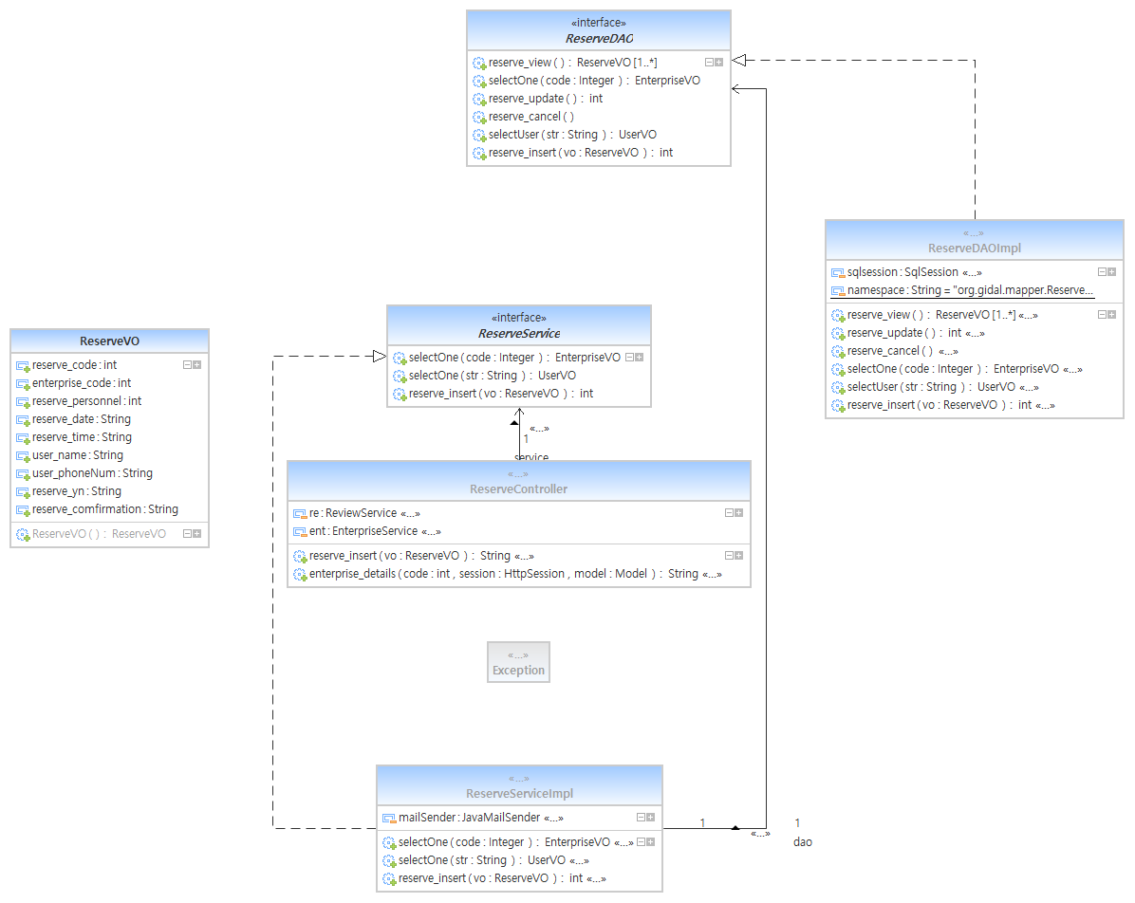
RESERVE

Slide 20
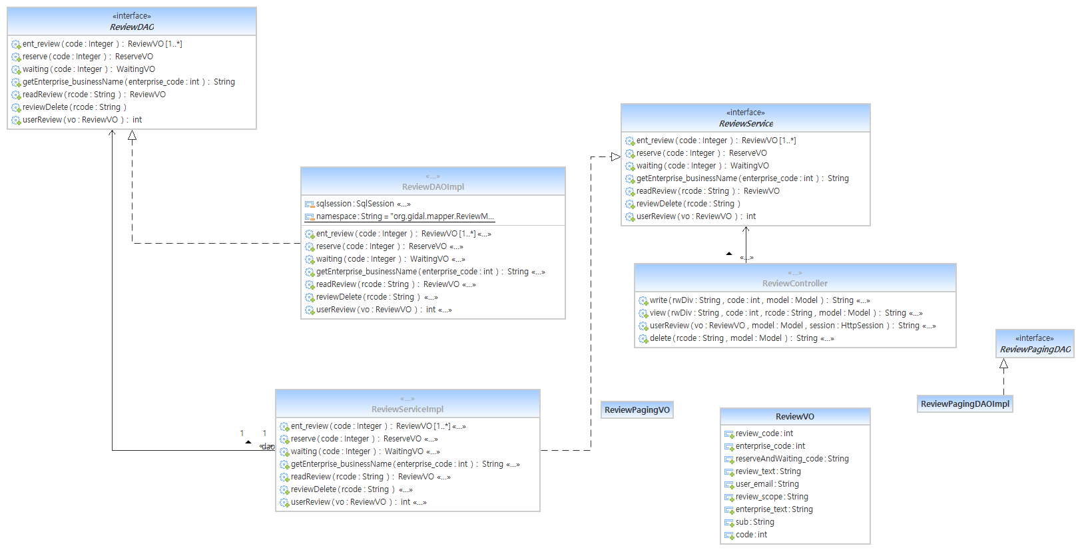
REVIEW

Slide 21
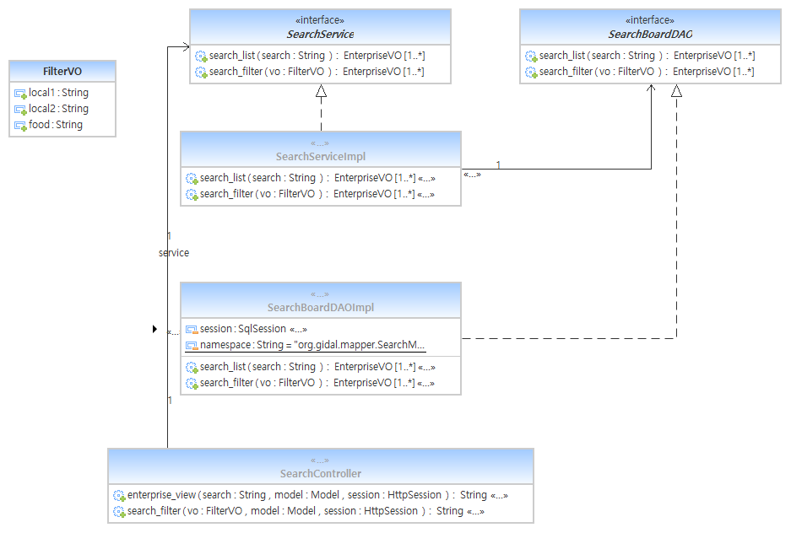
SEARCH

Slide 22
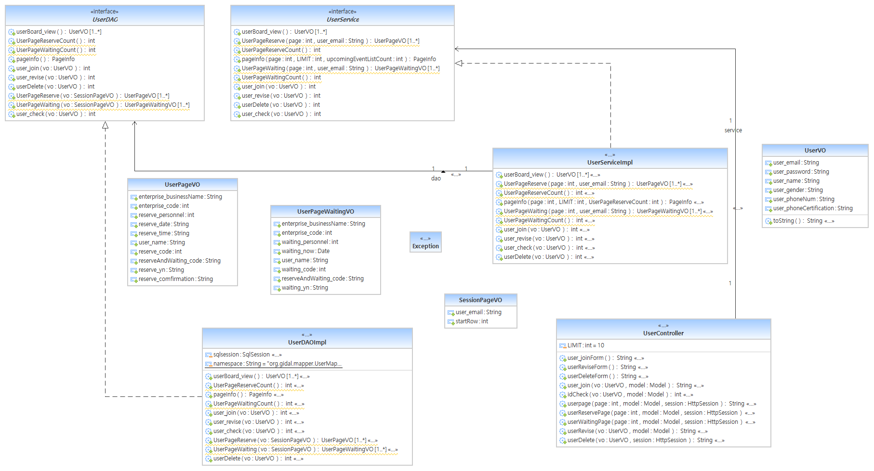
USER

Slide 23
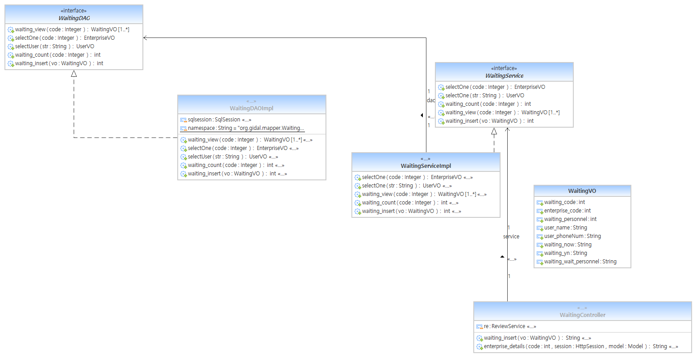
WAITING

